Slide 1

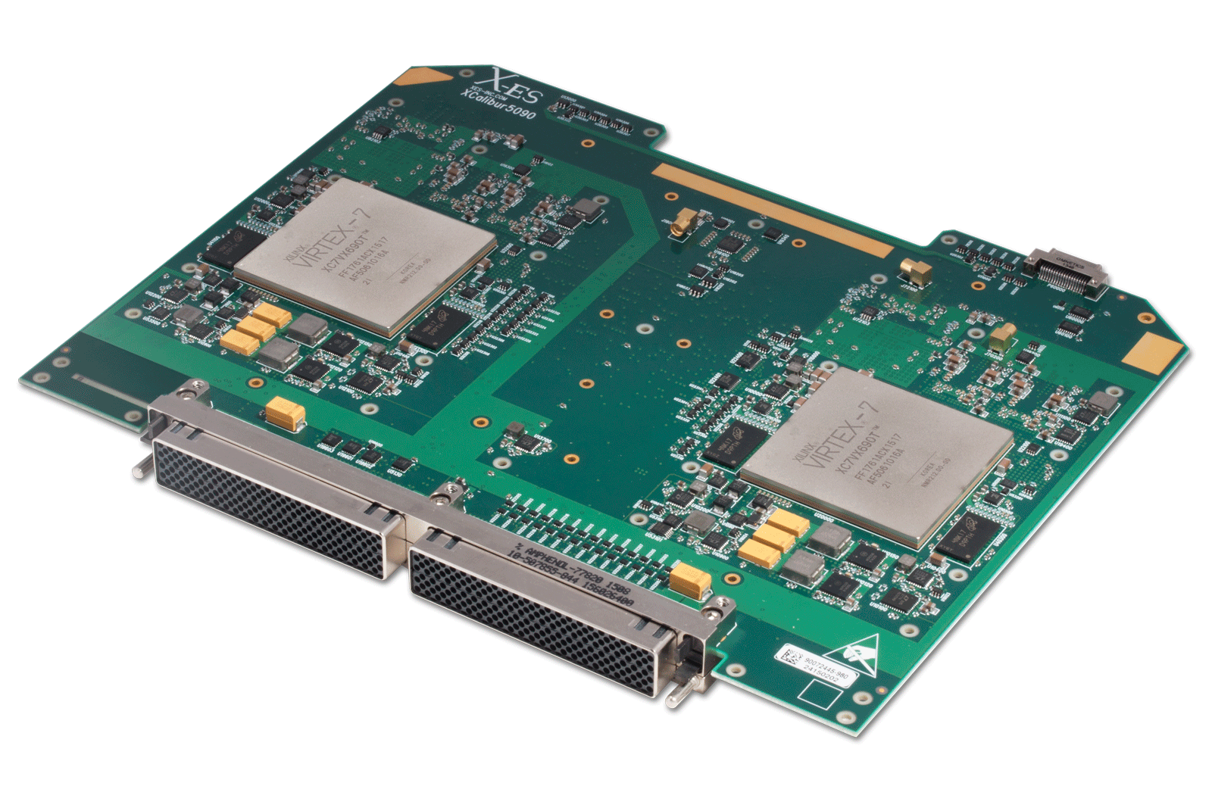

High-performance Networking Laboratory Director: Dr Ahmad Khonsari
VANET, Drone
Self Driving Car
NoC
Accelerators
IoT, Edge Computing
SDN and Cloud Computing
Security and Privacy
Big Data
A unique blend of basic and applied research, proving mathematical theorems on the one hand, and building practical systems on the other for improving the performance, dependability and security of computer and communication systems.

Slide 2
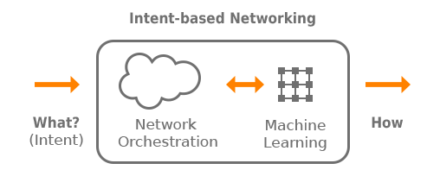
Intent-Based Networking (IBN) is a developing area of technology incorporating artificial intelligence (AI) and machine learning to automate administrative tasks across a network. The end goal of IBN is the creation of self-managing networks.
Gartner research: 75 percent of current networks are still managed manually
intent-based networking is based on telling the network what you want (your intent) rather than exactly what to do, on a technical level, to accomplish your goal.
According to many industry analysts, intent-based networking systems will be necessary to manage the networks of the future connecting data centers, public clouds and the Internet of Things (IoT).
Gartner predicts that IBN will be functioning in at least a thousand enterprise networks by 2020.

Slide 3
contact
Ahmad Khonsari
Main ECE Building, First Floor , Room 202
Web:
https://hpnl.ir
Email:
ak@ipm.ir, a_khonsari@ut.ac.ir

